Slide 1
Continuation of the Integrated Vaal River System Reconciliation Strategy Study: Phase2
8: Water Balance Status
Tuesday, 27 February 2018

Slide 2
Presentation Layout
Water balance status - SSC June 2015 recap
Revised information:
      Information from Annual Operating Analysis 2017:
        AMD Desalination date – January 2022
        High Water Requirement Scenarios - Rand Water
        Risk analysis of projected drought water restrictions
      Eskom water requirement projections - April 2017
      LHWP Phase 2 – transfer water by December 2025
Preliminary revised water balance
      Risk and difference analysis
2

Slide 3
Rand Water Supply Area Scenarios (2015)
Rand Water Projection
(October 2014)
Rand Water
(2003)
WC/WDM &
Tshwane Reuse
Historical Water Use
Dashed lines from January 2014 SSC
3

Slide 4
Water Requirements
(Net System Water Requirements)
High Water Requirements
Unlawful Removed
High Water Requirement Scenario
Water Conservation and Demand Management
Unlawful Removed
Re-use (Tshwane)
Dotted Lines = January 2014 Analysis
4
Notes:
This is the Net demand picture when we add all the other users
Explain

Slide 5
Water Balance (June 2015)
High with target WC/WDM | Desalination for urban use (from July 2018) | Unlawful removed | Re-use (Tshwane )
High water requirement
Unlawful removed
WC/WDM savings
Tshwane re-use
High water requirement
Unlawful removed
Short term availability due to current reservoir volumes
LHWP Phase II Yield
(Polihali Dam)
System
Yield
Yield increases due to desalination of mine water
Elevated risks without WC/WDM savings
First transfer from LHWP Phase II
5

Slide 6
Reconciliation Perspectives (2015)
The following are essential to maintain balance Until LHWP Phase 2 can deliver water:
Water Conservation & Water Demand Management
Eradication of Unlawful Use
Desalination and Re-use of Mine Water
Tshwane Re-use Project
6

Slide 7
Strategic Interventions (2015)
Eradication of unlawful water use by 2015.
Implementation of WC/WDM (project 15%) – achieve target savings by 2017.
Implement phase 2 of LHWP by 2023.
Mine water effluent treatment and use by 2018.
Tshwane water augmentation project (re-use).
Plan yield replacement scheme in orange.
Manage uncertainties: Vaal, Crocodile and Olifants.
Implementation of integrated water quality management plan.
7

Slide 8
Preliminary revised water balance
(February 2018)

Slide 9
Rand water demand projections for 2017/2018 AOA
High Water Requirement
Scenario
June 2015
Projection scenarios
Reduction in water use due to restrictions

Slide 10
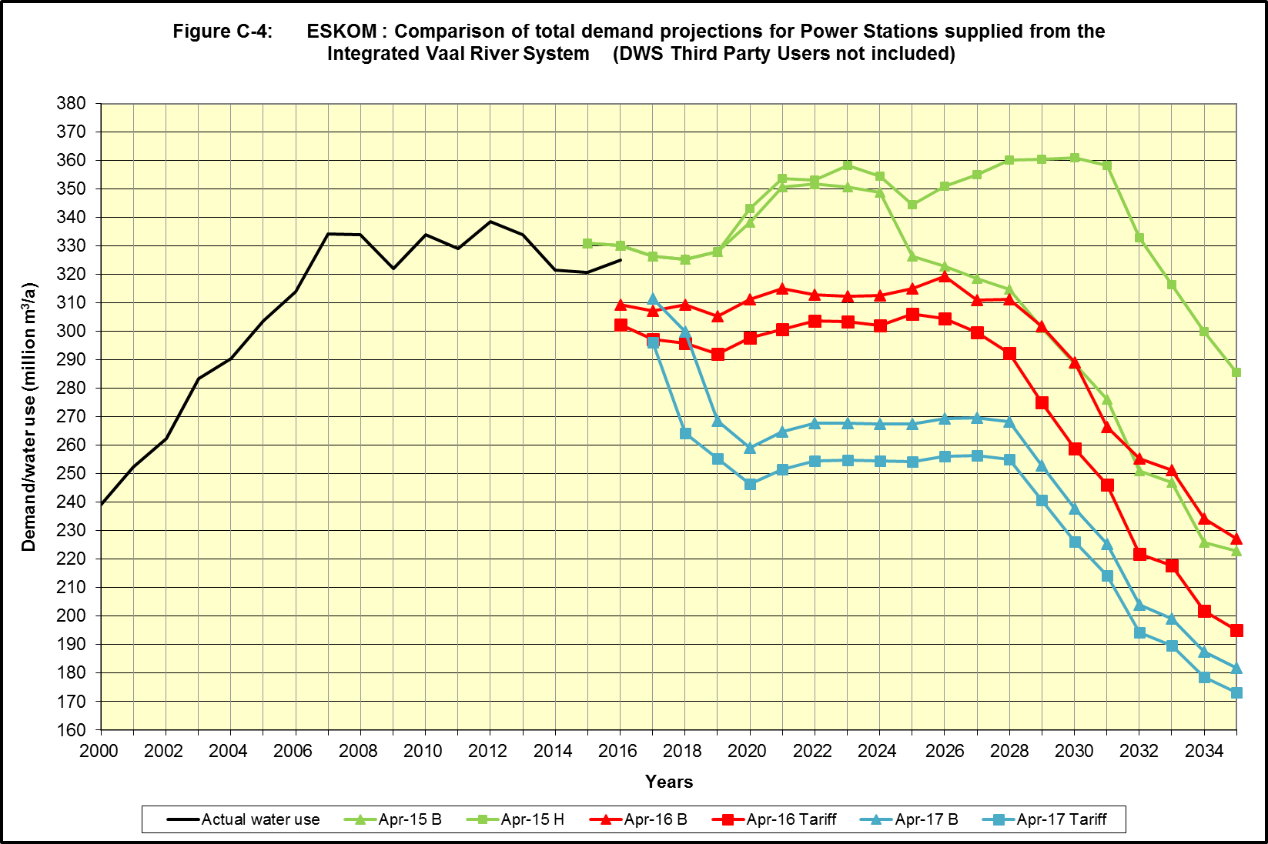
Eskom (Total for Integrated Vaal River System)
(April 2017 projection)
180 million m3/a
Reduction
Desalination of AMD January 2022

Slide 11
Water Requirements
(Net System Water Requirements)
High Water Requirements
Unlawful Removed
High Water Requirement Scenario
Water Conservation and Demand Management
Unlawful Removed
Re-use (Tshwane)
Dotted Lines = June 2015 Analysis
11
Notes:
This is the Net demand picture when we add all the other users
Explain

Slide 12
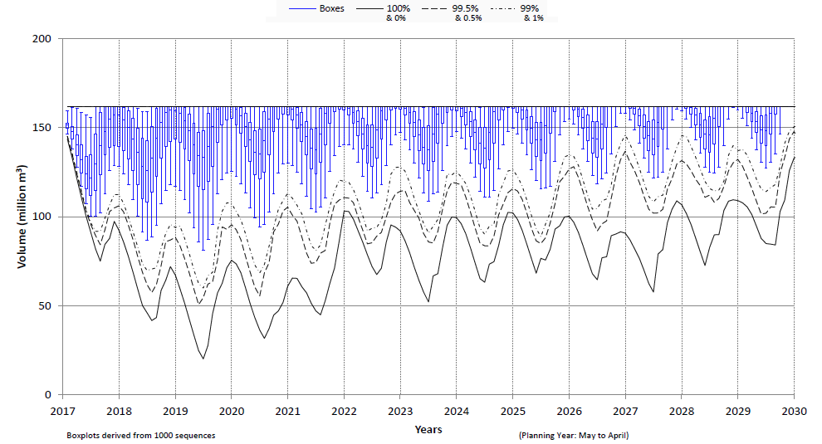
Storage Projection of the Komati System
(Risk analysis AOA June 2017)
Vygeboom and Nooitgedacht reservoirs
Unutilised Storage due to reduction in Eskom water requirements
Unutilised Yield @ (1:100 RI)
36 | 38 | 39 | 37 | 40 | 44 | 48 | 49 | 53 | 59 | 65

Slide 13
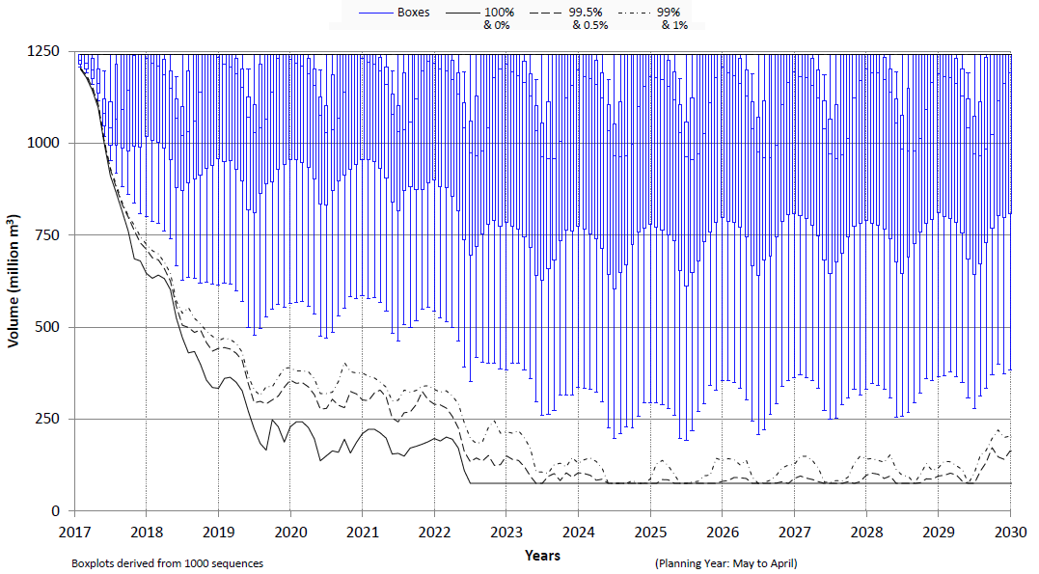
Storage Projection Bloemhof Dam
(Risk analysis AOA June 2017)
Unutilised storage due to dilution releases from Vaal Dam and return flows
DSV
Desalination of AMD January 2022

Slide 14
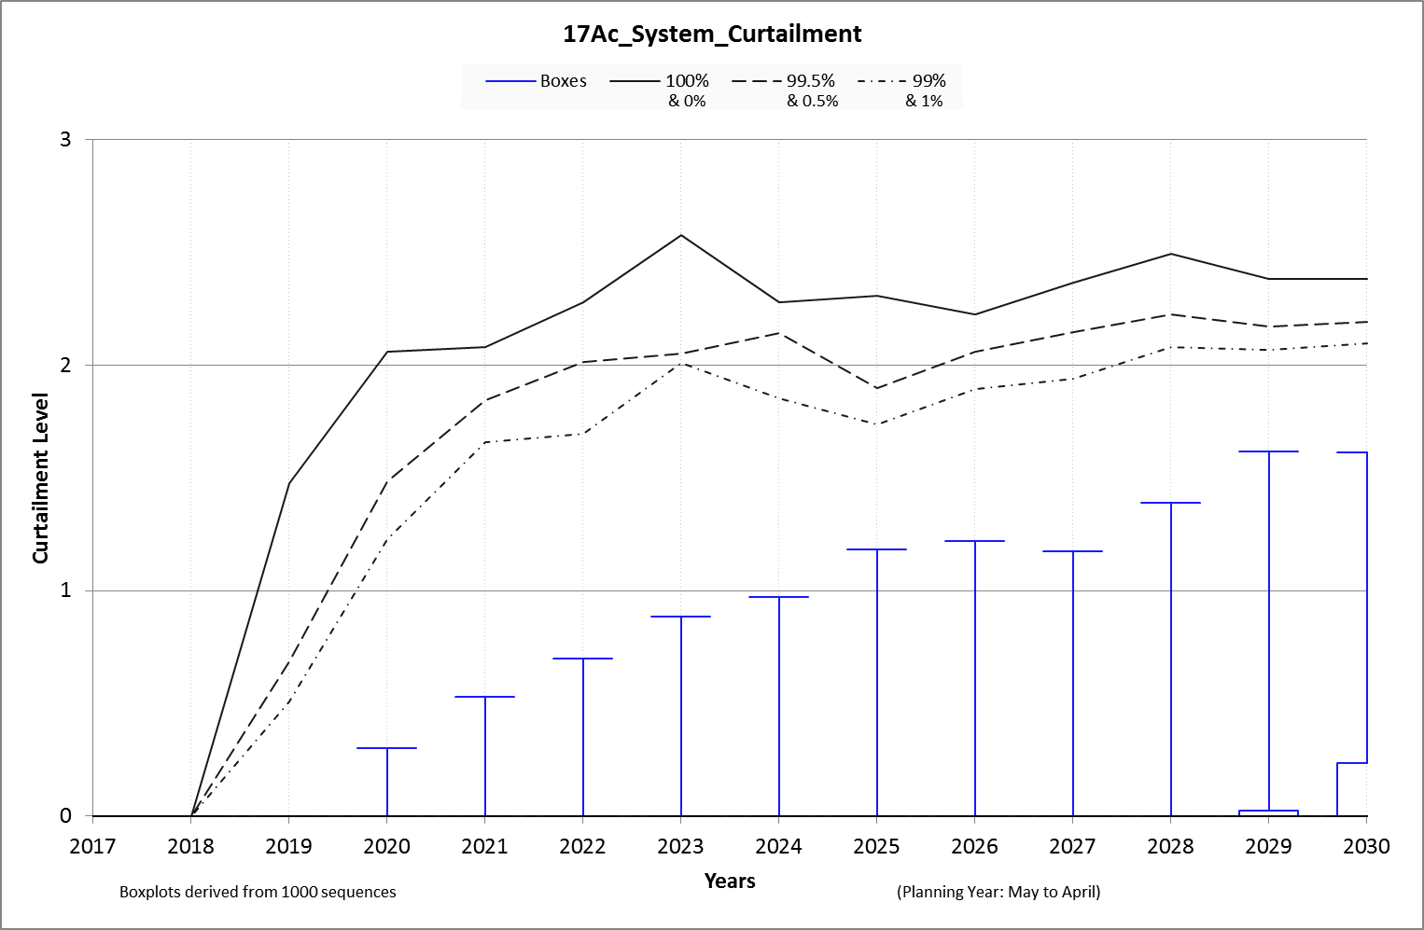
Risk of Drought Restrictions
(NB: Needs adjustments for unused storage in Komati and Bloemhof dams)
High Demand Scenario
Desalination Jan-2022
LHWP not implemented
By 2024 Level 1 Curtailment occurs at 5% risk:
50% Irrigation Curtailment
30% Urban Curtailment
Violation of Risk Criteria
0.5 %
min %
1 %
Min %
0.5 %
1.0 %
5.0 %
25 %
50 %
75 %
95 %
99 %
99.5 %
Max %
5 %

Slide 15
Preliminary Water Balance (February 2018)
High with target WC/WDM | Desalination for urban use (from January 2022) | Unlawful removed | Re-use (Tshwane )
High water requirement
Unlawful removed
WC/WDM savings
Tshwane re-use
High water requirement
Unlawful removed
Violation of risk criteria.
Elevated risk of restrictions.
LHWP Phase II Yield
(Polihali Dam)
Yield increases due to desalination of mine water
System
Yield
Elevated risks without WC/WDM savings
First transfer from LHWP Phase II – Dec 2025
15
Notes:
System yield accounts for:
Reduction due to excessive dilution prior to desalination of AMD.
Unused storage (yield) in Komati River System.

Slide 16
Observations
Reduction in system yield due to:
      Excessive dilution releases from Vaal Dam until desalination of AMD (January 2022.)
      Unused yield in Komati Subsystem due to reduction in Eskom power station water requirements.
Elevated risks of restrictions prior to implementation of LHWP Phase 2.
Further augmentation needed by:
      2030 - High Water Requirement Scenario
      2043 - High with WC\WDM savings
16

Slide 17
Reconciliation Perspectives (2015)
Water Conservation & Water Demand Management, Eradication of Unlawful Use, Desalination and Re-use of Mine Water as well as Tshwane Re-use Project are all essential to reduce the risk of restrictions Until LHWP Phase 2 can deliver water.
Prepare for augmentation from the Thukela Water Project.
      Revive Feasibility Study
17

Slide 18
Activities
Update irrigation water use with current V&V information.
Review yield capability of Thukela Water Project.
Track progress of interventions:
      Implementation of LHWP Phase 2.
      Mine water effluent treatment.
      Tshwane water augmentation project (re-use).
      WC/WDM savings.
Plan yield replacement scheme in orange.
Integration with Crocodile (west) and Olifants reconciliation interventions.
Implement integrated water quality management plan.
18

